Slide 1
Table Detection

Slide 2
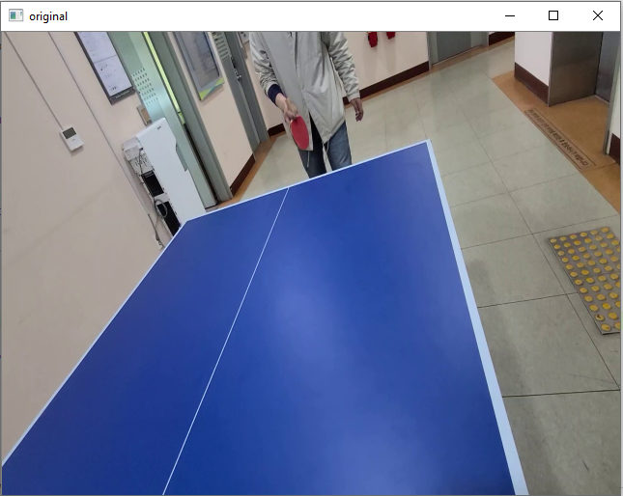
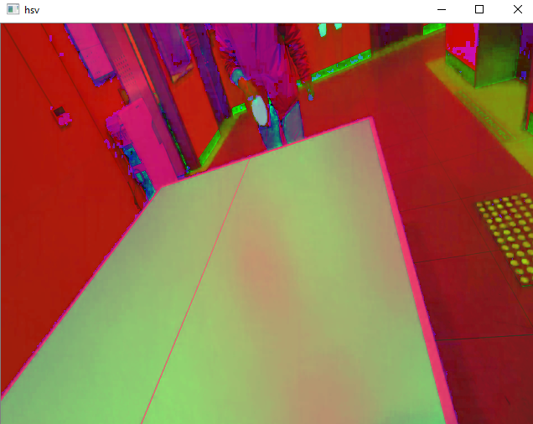
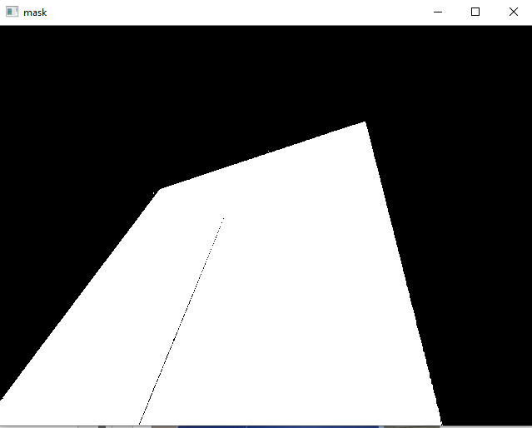
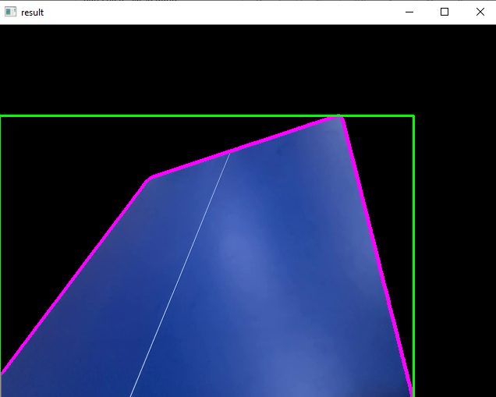
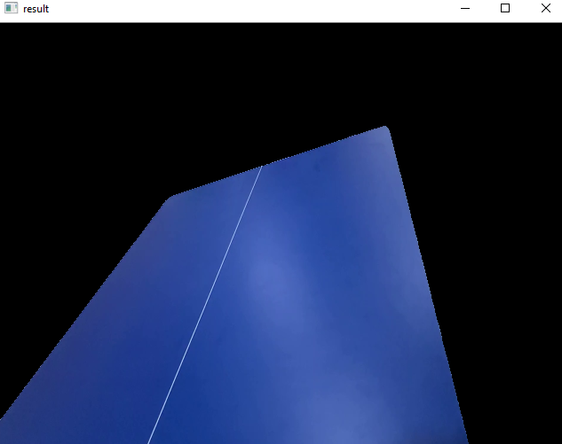
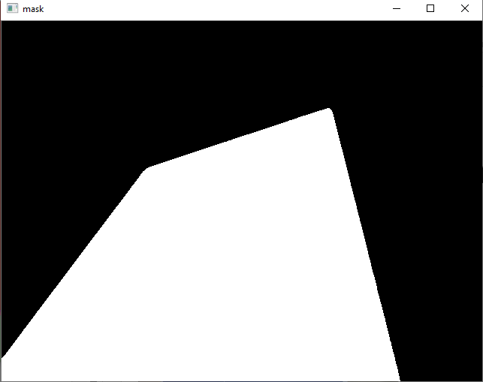
Table Detection
Input (RGB)
Input (HSV)
mask
Change Color space
Color detection
Median filter
Coutour and boundary
segmentation
Closed mask
Find contours
And-Bit Operator

Slide 3
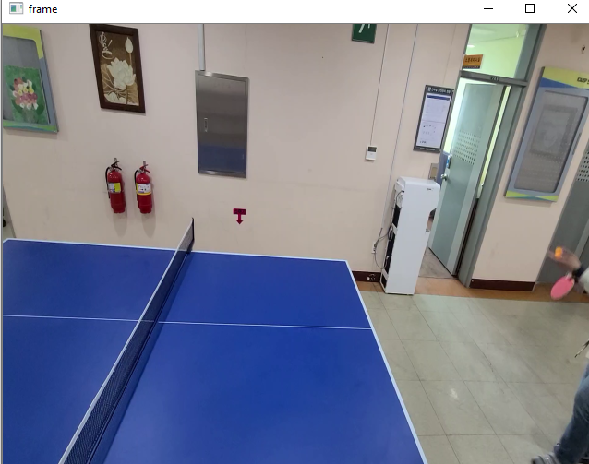
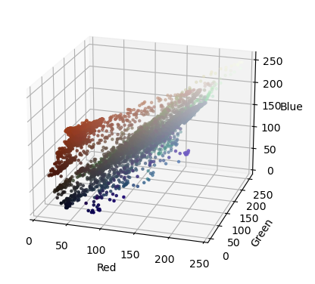
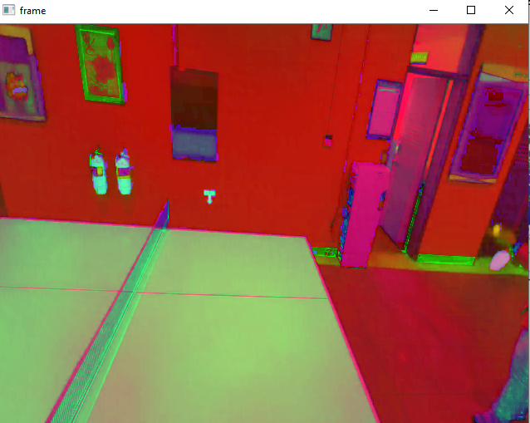
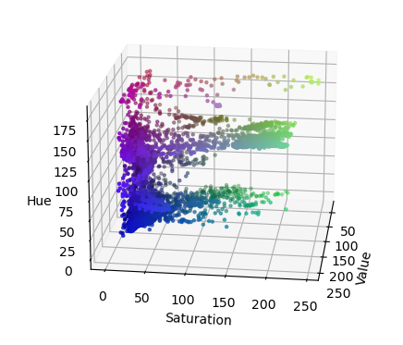
Histogram of colors
Histogram of HSV

Slide 4
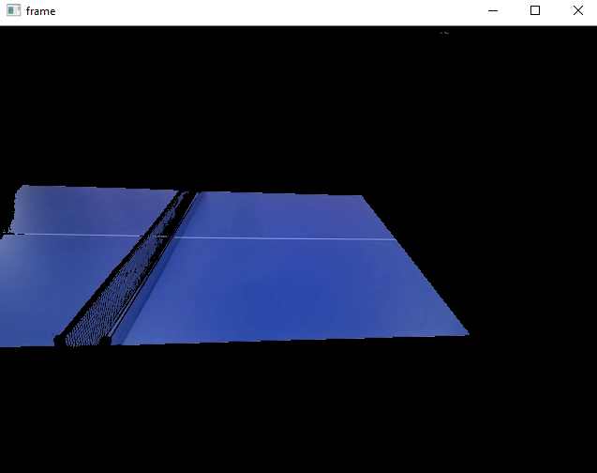
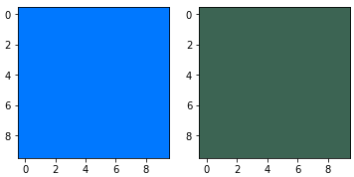
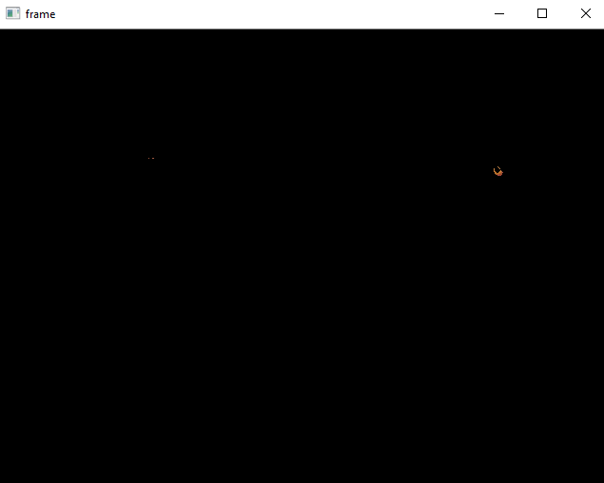
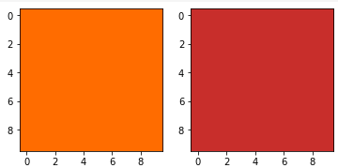
Table (blue color) search range
(150, 255, 255)
(110, 100, 100)
(20, 255, 255)
(5, 190, 200)
Ball (orange color) search range

Slide 5
Ball Detection

Slide 6
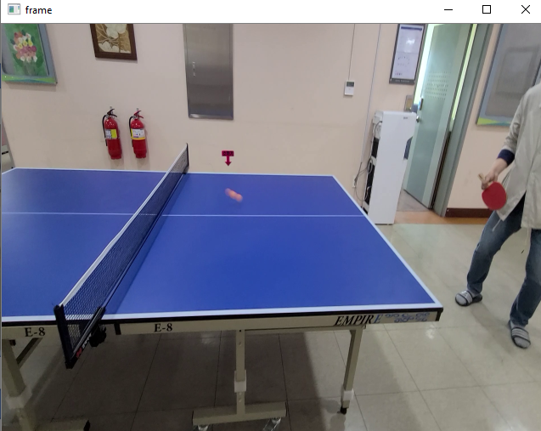
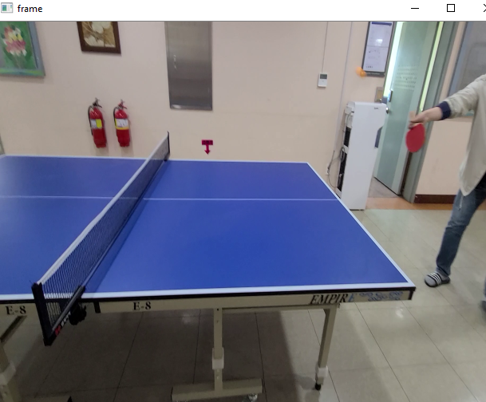
There are some difficulties when detecting the ball:
Ball is a moving object
Ball size a small
Ball color is inconsistent by frames (easily changed by background effects)

Slide 7
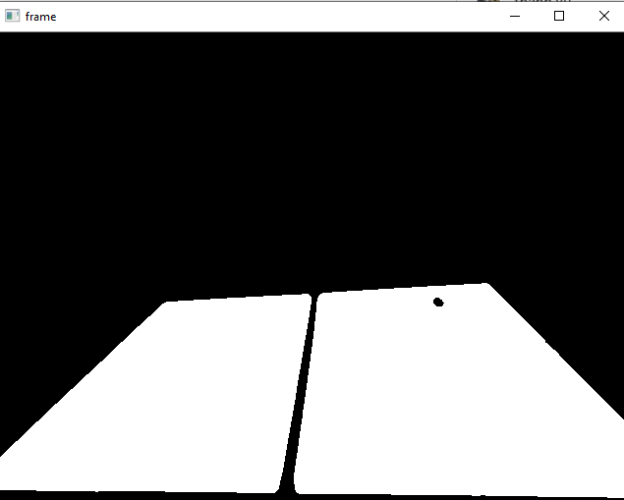
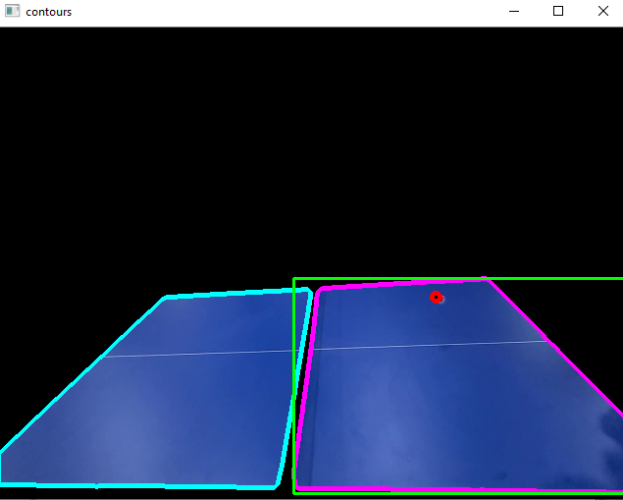
Detect ball by Hough Transform
https://www.geeksforgeeks.org/circle-detection-using-opencv-python/
https://en.wikipedia.org/wiki/Circle_Hough_Transform

Slide 8
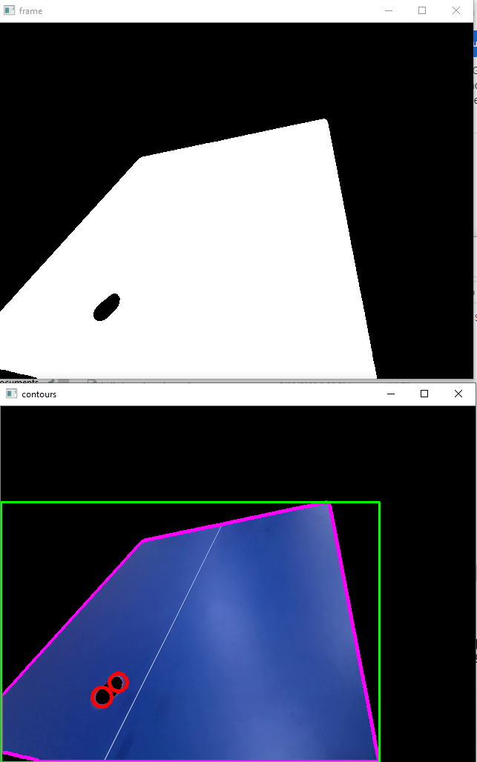
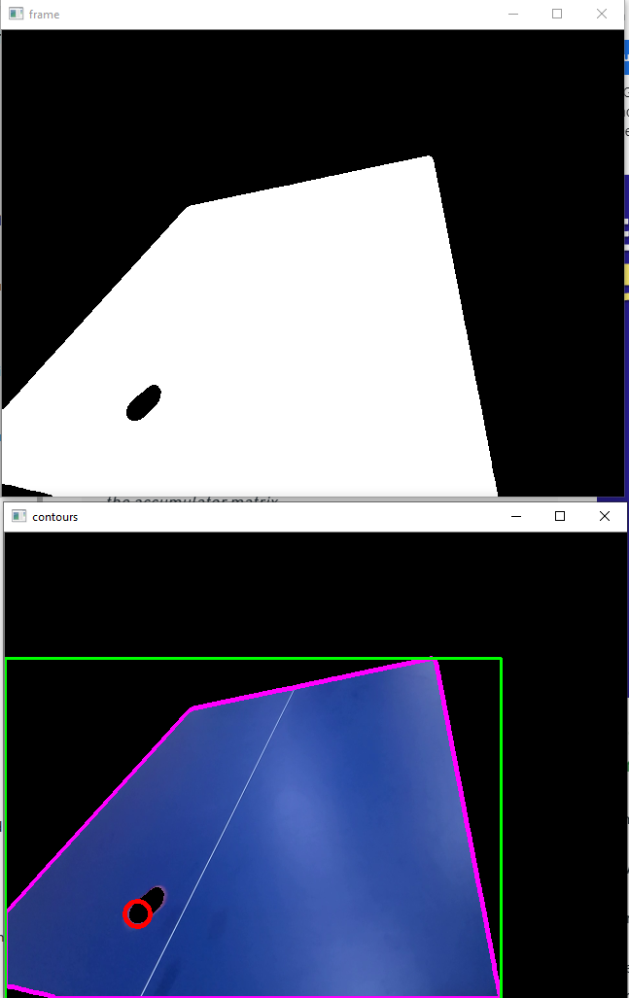
Shadow effect
Increase the distance between 2 detected circles to remove the shadow effect

Slide 10
References
HSV color space: https://en.wikipedia.org/wiki/HSL_and_HSV
Color Segmentation: https://realpython.com/python-opencv-color-spaces/
Contours:
https://docs.opencv.org/4.x/d4/d73/tutorial_py_contours_begin.html
https://learnopencv.com/contour-detection-using-opencv-python-c/
Hough transform:
https://www.geeksforgeeks.org/circle-detection-using-opencv-python/
https://en.wikipedia.org/wiki/Circle_Hough_Transform

Slide 11
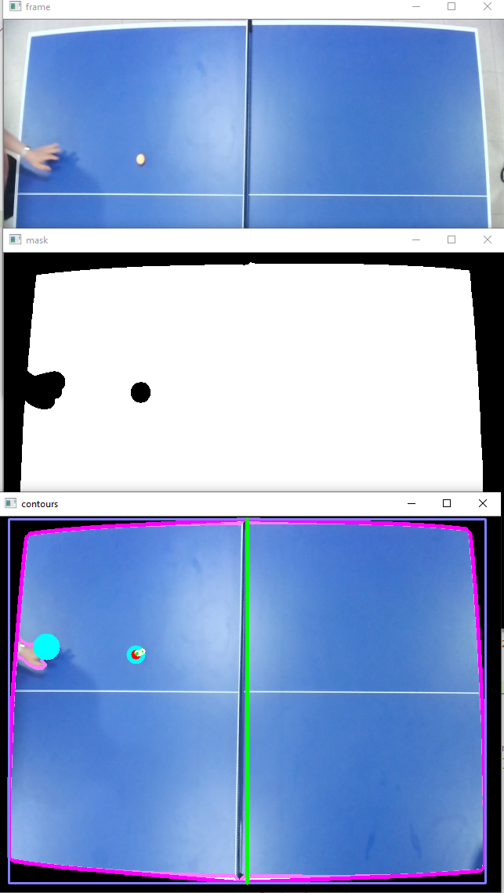
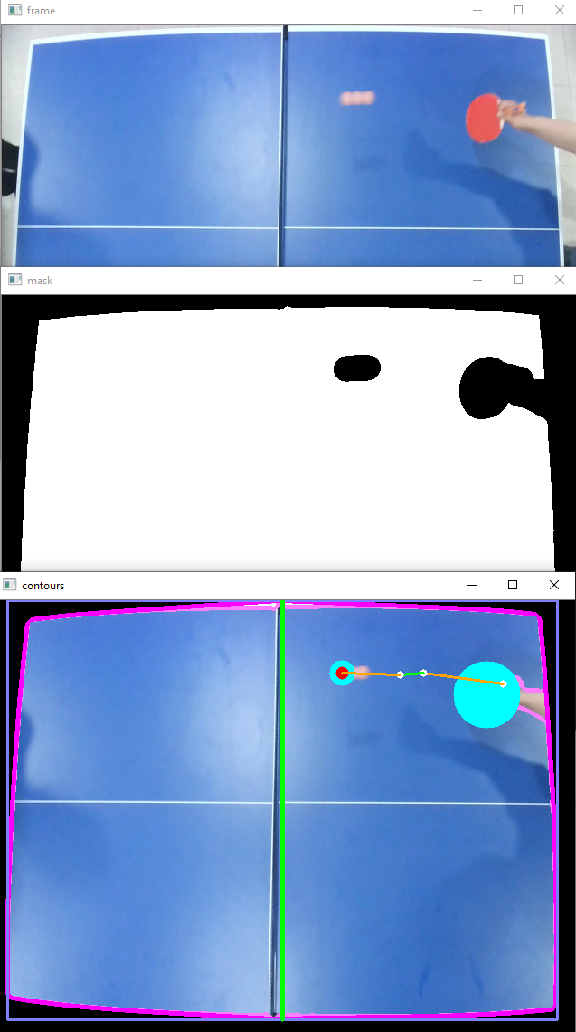
False detection
Eliminate false detection by calculating the length from segment to net:
=> The real ball is closer to the net than false segments

Slide 12
Scoring

